Slide 1
Data Analytics – Lesson 09 Crime in Chennai using R
Dr. Jeffrey Strickland

Slide 2
R Markdown
This is an R Markdown presentation. Markdown is a simple formatting syntax for authoring HTML, PDF, and MS Word documents. For more details on using R Markdown see http://rmarkdown.rstudio.com.

Slide 3
My dear Watson
“Sherlock Holmes was a man, however, who, when he had an unsolved problem upon his mind, would go for days, and even for a week, without rest, turning it over, rearranging his facts, looking at it from every point of view until he had either fathomed it or convinced himself that his data were insufficient.”
-Dr. John Watson, The Man with the Twisted Lip

Slide 4
Introduction - Simulated Crime Data for Chennai
Sherlock’s data may have been insufficient, but at present we cannot make the same complaint.
If we have any burden whatsoever, then it is possessing too much data.
Using R programming, we can make sense of the abundance of data police departments and/or city halls have already collected
cluster and describe data
create charts and other visuals that demonstrate patterns
model and predict future crimes
link unsolved crimes to past crimes and offenders

Slide 5
Objectives
Visualize spatial and temporal trends of criminal activity based on data
Analyze factors that may affect unlawful behavior based upon the data

Slide 6
Install R libraries
if(!require(readr)) install.packages("readr")
if(!require(dplyr)) install.packages("dplyr") if(!require(DT)) install.packages("DT")
if(!require(ggrepel)) install.packages("ggrepel")
if(!require(leaflet)) install.packages("leaflet")
library(leaflet) library(dplyr) library(ggplot2) library(scales)
library(ggrepel) library(DT)

Slide 7
The Crime Data
IncidntNum (T) Incident number
Category (T) Crime category, i.e., larceny/theft
Descript (T)
DayOfWeek (T)
Date (D Date: DD/MM/YYYY
Time (T) Time: 24-hour system
PdDistrict (T) Police district where incident occured
Resolution (T) Resolution of the crime
Address (T) Address of the crime
X (N) Longitude
Y (N) Latitude
Location (T) Lat/long
PdId (N) Police Department ID

Slide 8
Read the data
Load the data using readr and read_csv().
path <- "https://github.com/stricje1/VIT_University/blob/master/Crime_Analysis_Mapping/data/Chennai_crime.zip" df <- read_csv(path)
## Parsed with column specification: ## cols( ## IncidntNum = col_integer(), ## Category = col_character(), ## Descript = col_character(), ## DayOfWeek = col_character(), ## Date = col_character(), ## Time = col_time(format = ""), ## PdDistrict = col_character(), ## Resolution = col_character(), ## X = col_double(), ## Y = col_double(), ## )

Slide 9
Display Data
Display the data using DT and datatable().
df_sub <- df[1:100,] # display the first 100 rows df_sub$Time <- as.character(df_sub$Time) datatable(df_sub, options = list(pageLength = 5,scrollX='400px'))

Slide 10
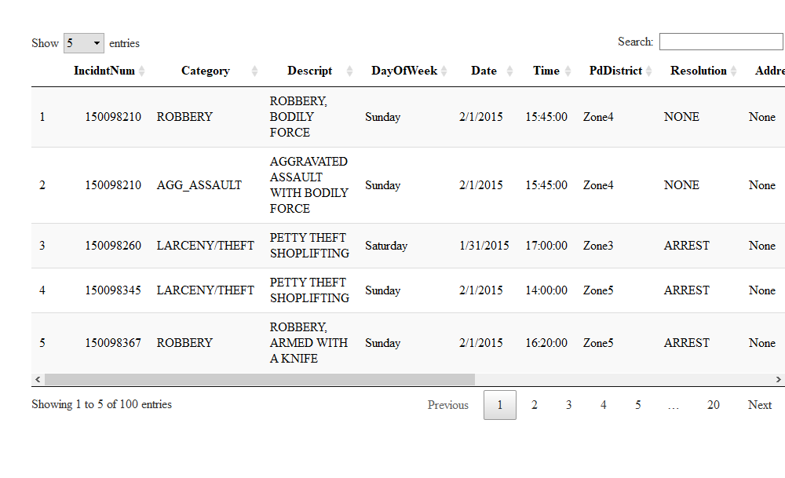

Slide 11
Preprocess Data
The All-Caps text is difficult to read.
Let’s force the text in the appropriate columns into proper case.
Using (dplyr)
proper_case <- function(x) { return (gsub("\\b([A-Z])([A-Z]+)", "\\U\\1\\L\\2" , x, perl=TRUE)) } df <- df %>% mutate(Category = proper_case(Category), Descript = proper_case(Descript), PdDistrict = proper_case(PdDistrict), Resolution = proper_case(Resolution), Time = as.character(Time)) df_sub <- df[1:100,] # display the first 100 rows datatable(df_sub, options = list(pageLength = 5,scrollX='400px'))

Slide 12
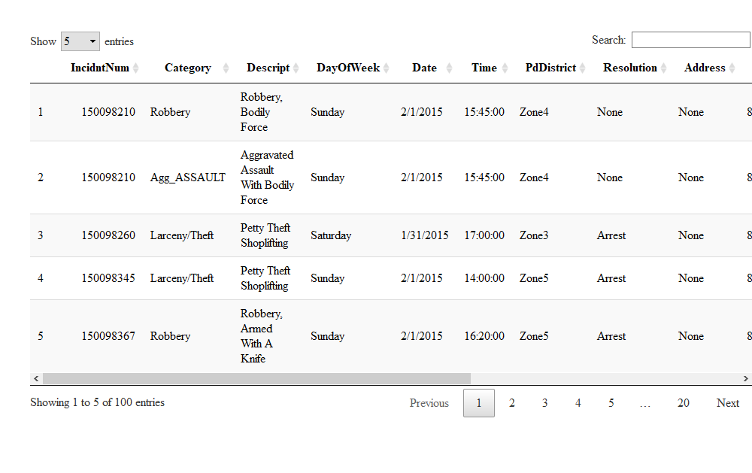

Slide 13
Visualize Data with Leaflet - Crime across space
data <- df[1:10000,] # display the first 10,000 rows data$popup <- paste("<b>Incident #: </b>", data$IncidntNum, "<br>", "<b>Category: </b>", data$Category, "<br>", "<b>Description: </b>", data$Descript, "<br>", "<b>Day of week: </b>", data$DayOfWeek, "<br>", "<b>Date: </b>", data$Date, "<br>", "<b>Time: </b>", data$Time, "<br>", "<b>PD district: </b>", data$PdDistrict, "<br>", "<b>Resolution: </b>", data$Resolution, "<br>", "<b>Address: </b>", data$Address, "<br>", "<b>Longitude: </b>", data$X, "<br>", "<b>Latitude: </b>", data$Y)

Slide 14
Plot Crime Clusters in Chennai
leaflet(data, width = "100%") %>% addTiles() %>% addTiles(group = "OSM (default)") %>% addProviderTiles(provider = "Esri.WorldStreetMap",group = "World StreetMap") %>% addProviderTiles(provider = "Esri.WorldImagery",group = "World Imagery") %>% # addProviderTiles(provider = "NASAGIBS.ViirsEarthAtNight2012",group = "Nighttime Imagery") %>% addMarkers(lng = ~X, lat = ~Y, popup = data$popup, clusterOptions = markerClusterOptions()) %>% addLayersControl( baseGroups = c("OSM (default)","World StreetMap", "World Imagery"), options = layersControlOptions(collapsed = FALSE) )

Slide 15
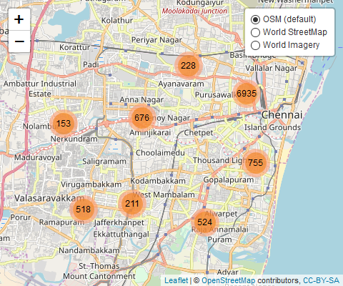
Crime Clusters in Chennai

Slide 16
Why Use Leaflet?
We can click icons on the map to show incident details
We need to set up some generate some parameters that we concatenate or “paste” together to form these incident descriptions
For example, the concatenated strings pdata$popup, provides the content of the an incident
You may notice the “%>%” or forward-pipe operator in the leaflet arguments
The operators pipe their left-hand side values forward into expressions that appear on the right-hand side, rather than from the inside and out
data$popup[1]
## [1] "<b>Incident #: </b> 150098210 <br> <b>Category: </b> Robbery <br> <b>Description: </b> Robbery, Bodily Force <br> <b>Day of week: </b> Sunday <br> <b>Date: </b> 2/1/2015 <br> <b>Time: </b> 15:45:00 <br> <b>PD district: </b> Zone4 <br> <b>Resolution: </b> None <br> <b>Address: </b> None <br> <b>Longitude: </b> 80.26669397 <br> <b>Latitude: </b> 13.09199072"

Slide 17
Crime Over Time - the Crime Series
Crime series - akin to time series
Manipulate the data using the dplyr::mutate function
Mutate adds new variables while preserving extisting variables
We can add the Hours variable using the Time with hh:mm format
We can make the Year variable using the Date with mm/dd/yyyy format

Slide 18
Mutate Date to Days
Using (dplyr)
df_crime_daily <- df %>% mutate(Date = as.Date(Date, "%m/%d/%Y")) %>% group_by(Date) %>% summarize(count = n()) %>% arrange(Date)

Slide 19
Daily Crimes Series with Smoothing
Using (ggplot2) and (scales)
plot <- ggplot(df_crime_daily, aes(x = Date, y = count)) + geom_line(color = "#F2CA27", size = 0.1) + geom_smooth(color = "#1A1A1A") + # fte_theme() + scale_x_date(breaks = date_breaks("1 year"), labels = date_format("%Y")) + labs(x = "Date of Crime", y = "Number of Crimes", title = "Daily Crimes in Chennai from 2009 - 2018") plot
## `geom_smooth()` using method = 'gam' and formula 'y ~ s(x, bs = "cs")'

Slide 20
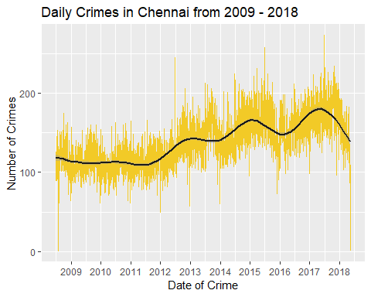

Slide 21
Aggregate the Crime Data
df_category <- sort(table(df$Category),decreasing = TRUE) df_category <- data.frame(df_category[df_category > 1000]) colnames(df_category) <- c("Category", "Frequency") df_category$Percentage <- df_category$Frequency / sum(df_category$Frequency) datatable(df_category, options = list(scrollX='400px'))

Slide 22
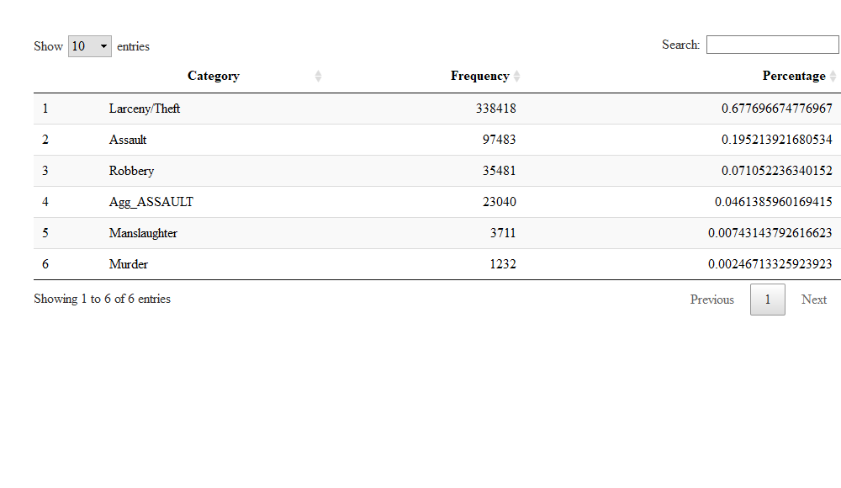

Slide 23
Create Crime Category a Bar Chart
Using (ggplot2) and (ggrepel)
bp<-ggplot(df_category, aes(x=Category, y=Frequency, fill=Category)) + geom_bar(stat="identity") + theme(axis.text.x=element_blank()) + geom_text_repel(data=df_category, aes(label=Category)) bp

Slide 24
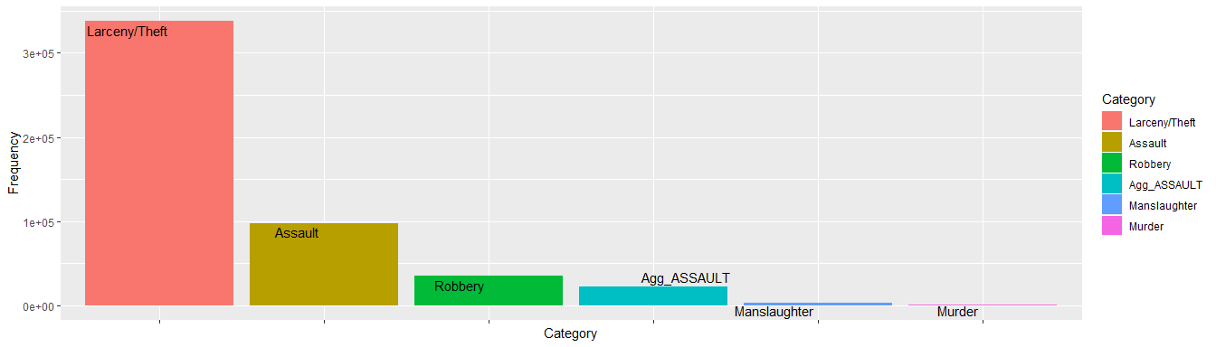

Slide 25
Create a Crime Category Pie Chart
bp<-ggplot(df_category, aes(x="", y=Percentage, fill=Category)) + geom_bar(stat="identity") pie <- bp + coord_polar("y") pie

Slide 26


Slide 27
Temporal Trends
Theft Over Time
Arrests over time
Daily arrests
Number of Arrest by Time-of-Day
Number of Arrest by Day-of-Week
Number of Arrest by Day-of-Week and Time-of-Day

Slide 28
Thefts Over Time
df_theft <- df %>% filter(grepl("Larceny/Theft", Category)) df_theft_daily <- df_theft %>% mutate(Date = as.Date(Date, "%m/%d/%Y")) %>% group_by(Date) %>% summarize(count = n()) %>% arrange(Date)

Slide 29
Plot Temporal Trends - Daily Thefts
plot <- ggplot(df_theft_daily, aes(x = Date, y = count)) + geom_line(color = "#00ccff", size = 0.1) + geom_smooth(color = "#1A1A1A") + # fte_theme() + scale_x_date(breaks = date_breaks("1 year"), labels = date_format("%Y")) + labs(x = "Date of Theft", y = "Number of Thefts", title = "Daily Thefts in Chennai from 2009 to 2018") plot
## `geom_smooth()` using method = 'gam' and formula 'y ~ s(x, bs = "cs")'

Slide 30
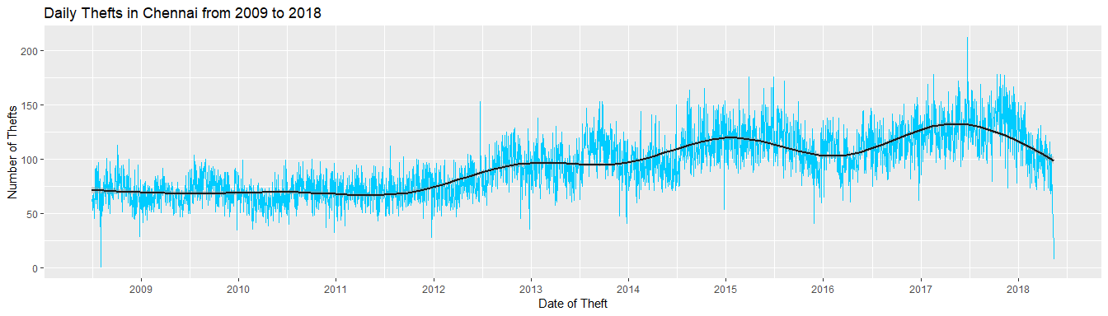

Slide 31
Time of Theft Heatmap Process
get_hour <- function(x) { return (as.numeric(strsplit(x,":")[[1]][1])) } df_theft_time <- df_theft %>% mutate(Hour = sapply(Time, get_hour)) %>% group_by(DayOfWeek, Hour) %>% summarize(count = n()) datatable(df_theft_time, options = list(scrollX='400px'))

Slide 32
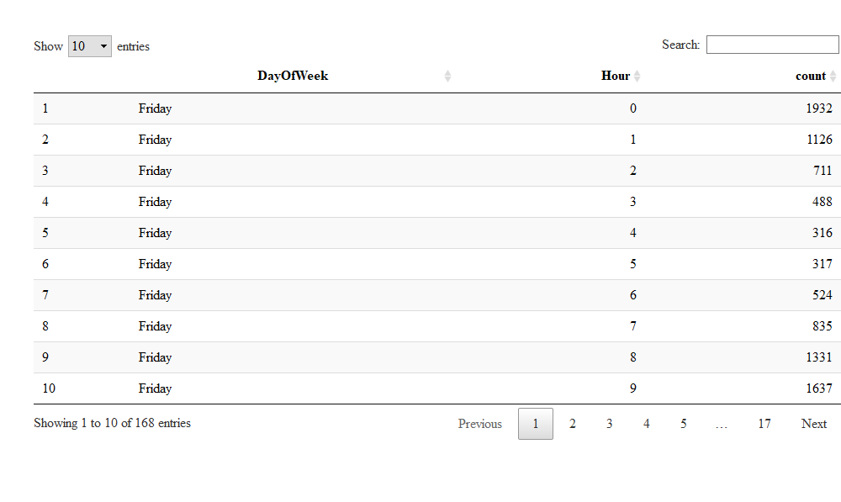

Slide 33
Reorder and Format Factors
dow_format <- c("Sunday","Monday","Tuesday","Wednesday","Thursday","Friday","Saturday") hour_format <- c(paste(c(12,1:11),"AM"), paste(c(12,1:11),"PM")) df_theft_time$DayOfWeek <- factor(df_theft_time$DayOfWeek, level = rev(dow_format)) df_theft_time$Hour <- factor(df_theft_time$Hour, level = 0:23, label = hour_format) datatable(df_theft_time, options = list(scrollX='400px'))

Slide 34
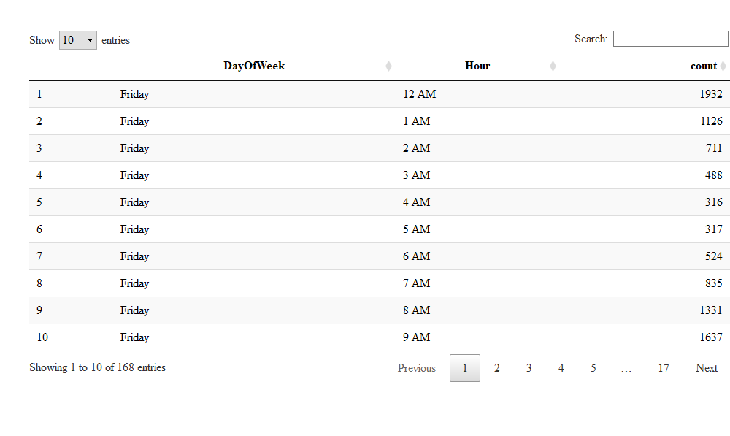

Slide 35
Create Time of Theft Heatmap
plot <- ggplot(df_theft_time, aes(x = Hour, y = DayOfWeek, fill = count)) + geom_tile() + # fte_theme() + theme(axis.text.x = element_text(angle = 90, vjust = 0.6), legend.title = element_blank(), legend.position="top", legend.direction="horizontal", legend.key.width=unit(2, "cm"), legend.key.height=unit(0.25, "cm"), legend.margin=unit(-0.5,"cm"), panel.margin=element_blank()) + labs(x = "Hour of Theft (Local Time)", y = "Day of Week of Theft", title = "Number of Thefts in Chennai from 2009 to 2018, by Time of Theft") + scale_fill_gradient(low = "white", high = "#27AE60", labels = comma)
## Warning: `panel.margin` is deprecated. Please use `panel.spacing` property ## instead
## Warning: `legend.margin` must be specified using `margin()`. For the old ## behavior use legend.spacing
plot

Slide 36
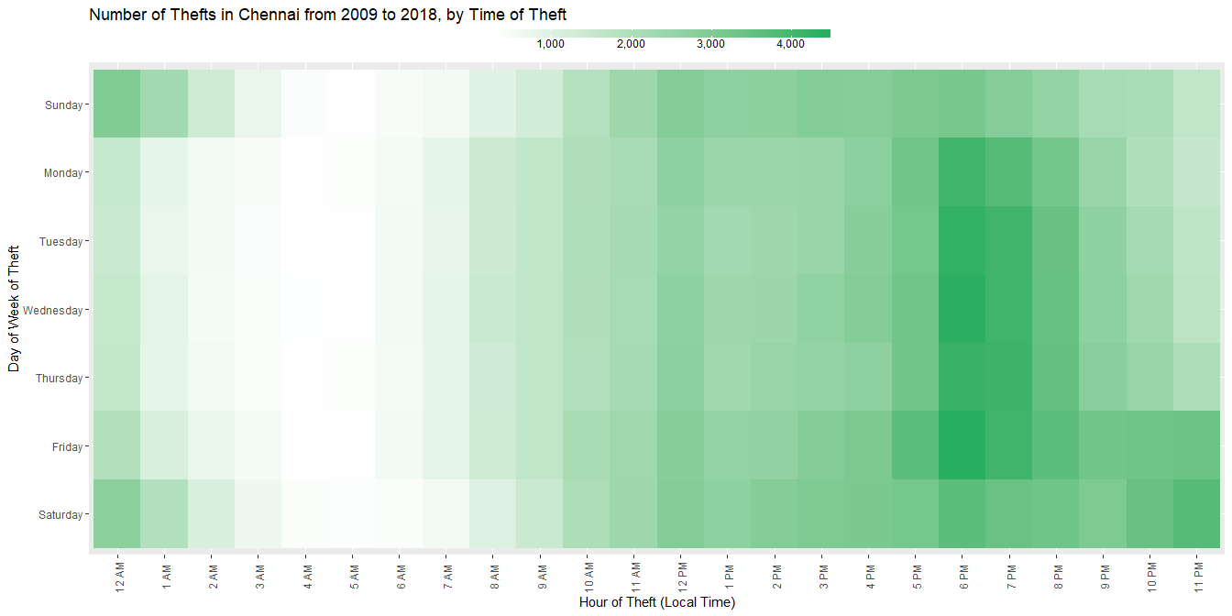

Slide 37
Arrest Over Time
df_arrest <- df %>% filter(grepl("Arrest", Resolution)) df_arrest_daily <- df_arrest %>% mutate(Date = as.Date(Date, "%m/%d/%Y")) %>% group_by(Date) %>% summarize(count = n()) %>% arrange(Date)

Slide 38
Daily Arrests
library(ggplot2) library(scales) plot <- ggplot(df_arrest_daily, aes(x = Date, y = count)) + geom_line(color = "#F2CA27", size = 0.1) + geom_smooth(color = "#1A1A1A") + # fte_theme() + scale_x_date(breaks = date_breaks("1 year"), labels = date_format("%Y")) + labs(x = "Date of Arrest", y = "# of Police Arrests", title = "Daily Police Arrests in Chennai from 2009 to 2018") plot
## `geom_smooth()` using method = 'gam' and formula 'y ~ s(x, bs = "cs")'

Slide 39
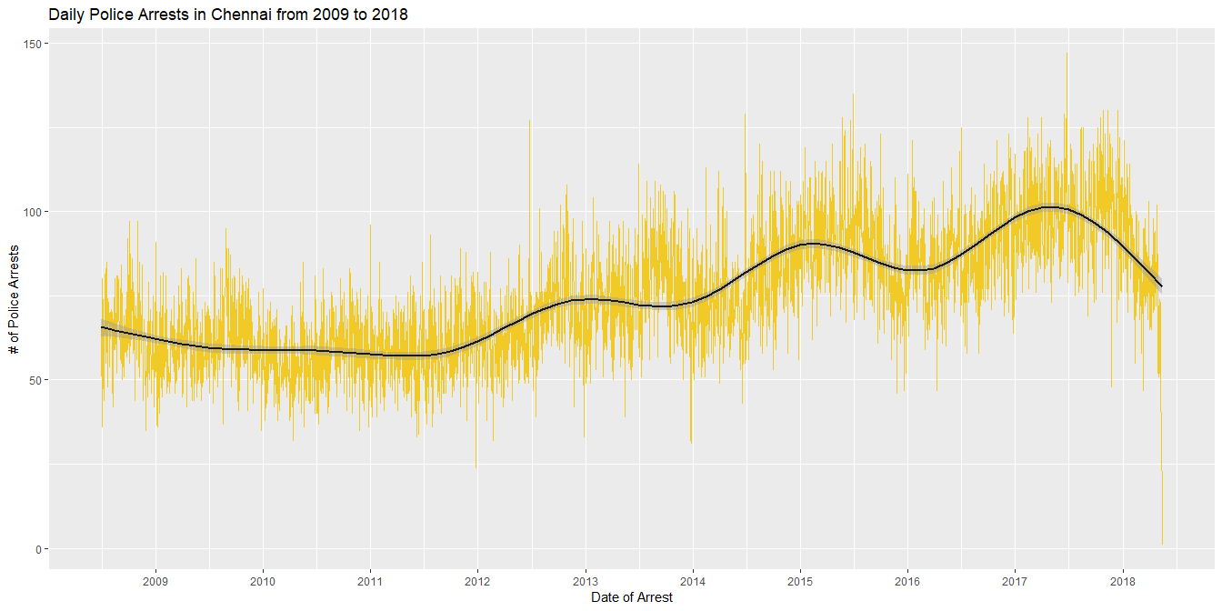

Slide 40
Number of Arrest by Time of Arrest
get_hour <- function(x) { return (as.numeric(strsplit(x,":")[[1]][1])) } df_arrest_time <- df_arrest %>% mutate(Hour = sapply(Time, get_hour)) %>% group_by(DayOfWeek, Hour) %>% summarize(count = n()) dow_format <- c("Sunday","Monday","Tuesday","Wednesday","Thursday","Friday","Saturday") hour_format <- c(paste(c(12,1:11),"AM"), paste(c(12,1:11),"PM")) df_arrest_time$DayOfWeek <- factor(df_arrest_time$DayOfWeek, level = rev(dow_format)) df_arrest_time$Hour <- factor(df_arrest_time$Hour, level = 0:23, label = hour_format)

Slide 41
Plot of Number of Arrest by Time of Arrest
plot <- ggplot(df_arrest_time, aes(x = Hour, y = DayOfWeek, fill = count)) + geom_tile() + # fte_theme() + theme(axis.text.x = element_text(angle = 90, vjust = 0.6), legend.title = element_blank(), legend.position="top", legend.direction="horizontal", legend.key.width=unit(2, "cm"), legend.key.height=unit(0.25, "cm"), legend.margin=unit(-0.5,"cm"), panel.margin=element_blank()) + labs(x = "Hour of Arrest (Local Time)", y = "Day of Week of Arrest", title = "Number of Police Arrests in Chennai from 2009 - 2018, by Time of Arrest") + scale_fill_gradient(low = "white", high = "#008000", labels = comma)
## Warning: `panel.margin` is deprecated. Please use `panel.spacing` property ## instead
## Warning: `legend.margin` must be specified using `margin()`. For the old ## behavior use legend.spacing
plot

Slide 42
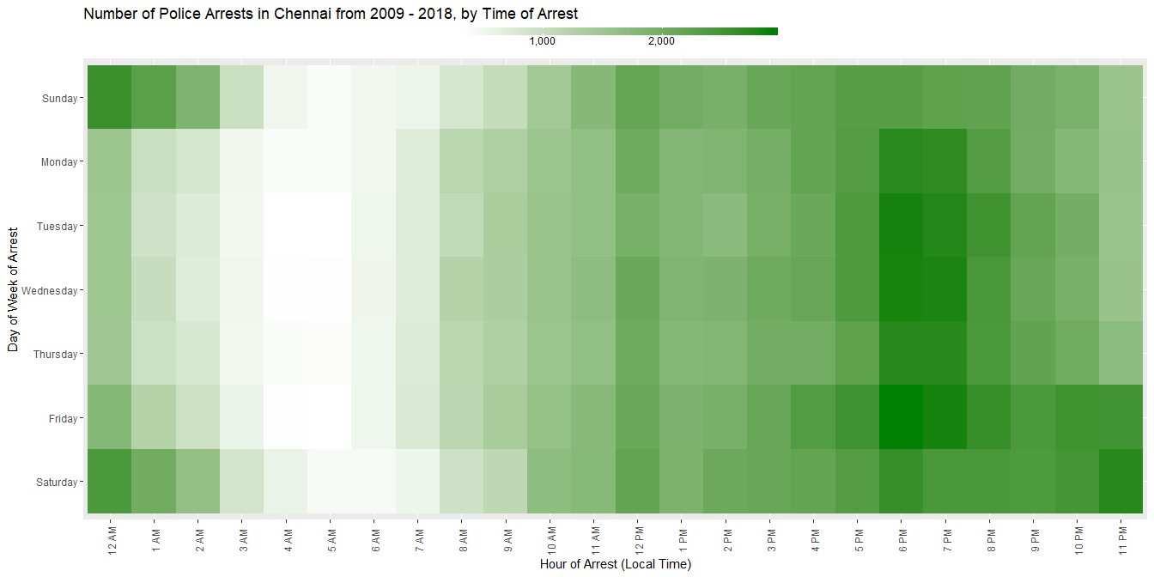

Slide 43
Correlation Analysis - Number of Arrests
Arrest by Crime Category
Arrests by Category and time of Arrest
Arrests by Category, Normalized by Time of Arrest
Arrest by Time, Normalized by Police District
Arrests Time of Arrest, Normalized by Month
Arrests by Time, Normalized by Year

Slide 44
Arrest by Crime Category
df_top_crimes <- df_arrest %>% group_by(Category) %>% summarize(count = n()) %>% arrange(desc(count)) datatable(df_top_crimes, options = list(pageLength = 10,scrollX='400px'))

Slide 45
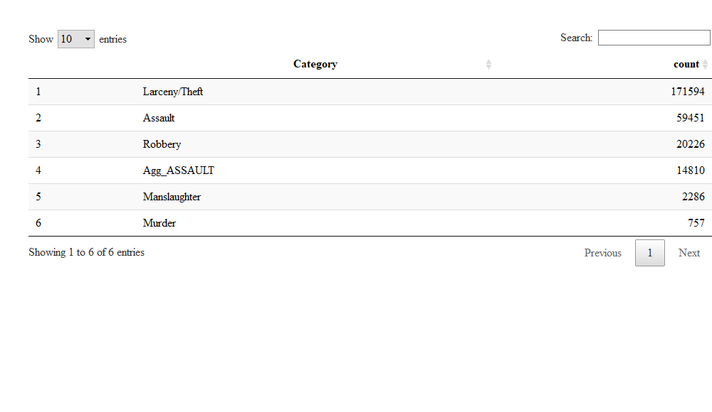

Slide 46
Arrests by Category and time of Arrest
df_arrest_time_crime <- df_arrest %>% filter(Category %in% df_top_crimes$Category[2:19]) %>% mutate(Hour = sapply(Time, get_hour)) %>% group_by(Category, DayOfWeek, Hour) %>% summarize(count = n()) df_arrest_time_crime$DayOfWeek <- factor(df_arrest_time_crime$DayOfWeek, level = rev(dow_format)) df_arrest_time_crime$Hour <- factor(df_arrest_time_crime$Hour, level = 0:23, label = hour_format) datatable(df_arrest_time_crime, options = list(pageLength = 10,scrollX='400px'))

Slide 47
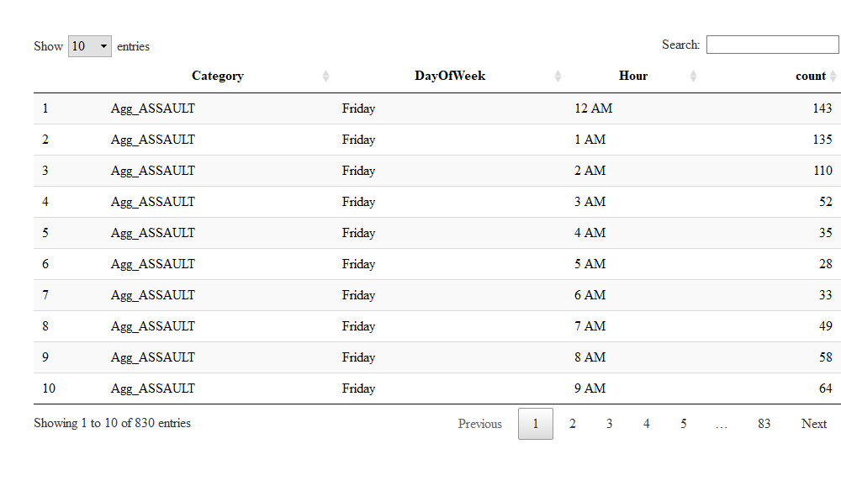

Slide 48
Plot of Arrests by Category and Time of Arrest
plot <- ggplot(df_arrest_time_crime, aes(x = Hour, y = DayOfWeek, fill = count)) + geom_tile() + # fte_theme() + theme(axis.text.x = element_text(angle = 90, vjust = 0.6, size = 4)) + labs(x = "Hour of Arrest (Local Time)", y = "Day of Week of Arrest", title = "Number of Police Arrests in Chennai from 2014 to 2018, by Category and Time of Arrest") + scale_fill_gradient(low = "#d7b4ff", high = "#24004b") + facet_wrap(~ Category, nrow = 6) plot

Slide 49
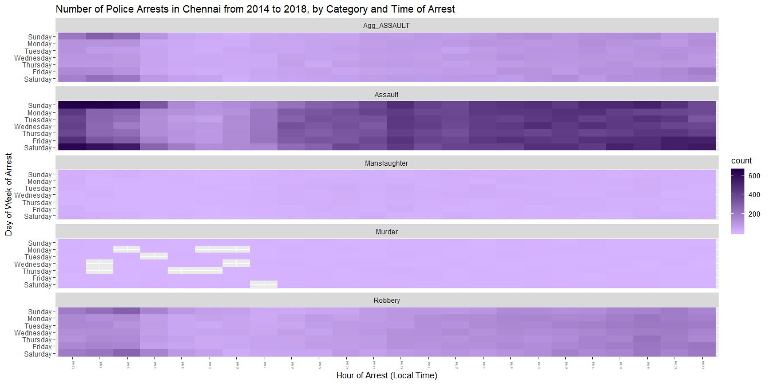

Slide 50
Normailzed Gradients
df_arrest_time_crime <- df_arrest_time_crime %>% group_by(Category) %>% mutate(norm = count/sum(count)) datatable(df_arrest_time_crime, options = list(pageLength = 10,scrollX='400px'))

Slide 51
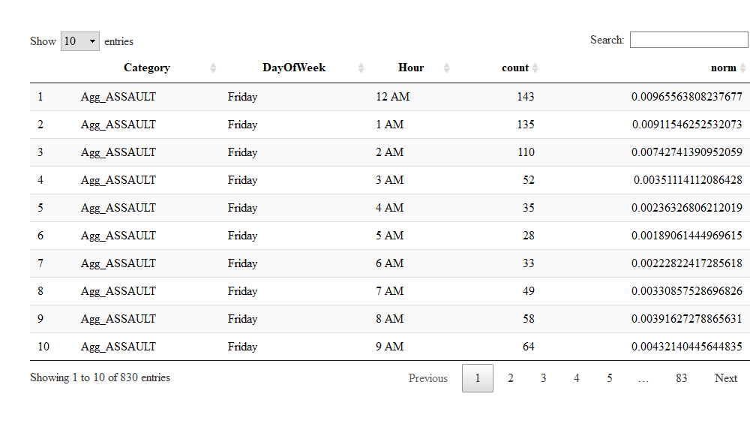

Slide 52
Normalized Number of Arrests by Category and Time of Arrest
plot <- ggplot(df_arrest_time_crime, aes(x = Hour, y = DayOfWeek, fill = norm)) + geom_tile() + # fte_theme() + theme(axis.text.x = element_text(angle = 90, vjust = 0.6, size = 4)) + labs(x = "Hour of Arrest (Local Time)", y = "Day of Week of Arrest", title = "Police Arrests in Chennai from 2014 to 2018 by Time of Arrest, Normalized by Type of Crime") + scale_fill_gradient(low = "#4dd2ff", high = "#00008b") + facet_wrap(~ Category, nrow = 6) plot

Slide 53
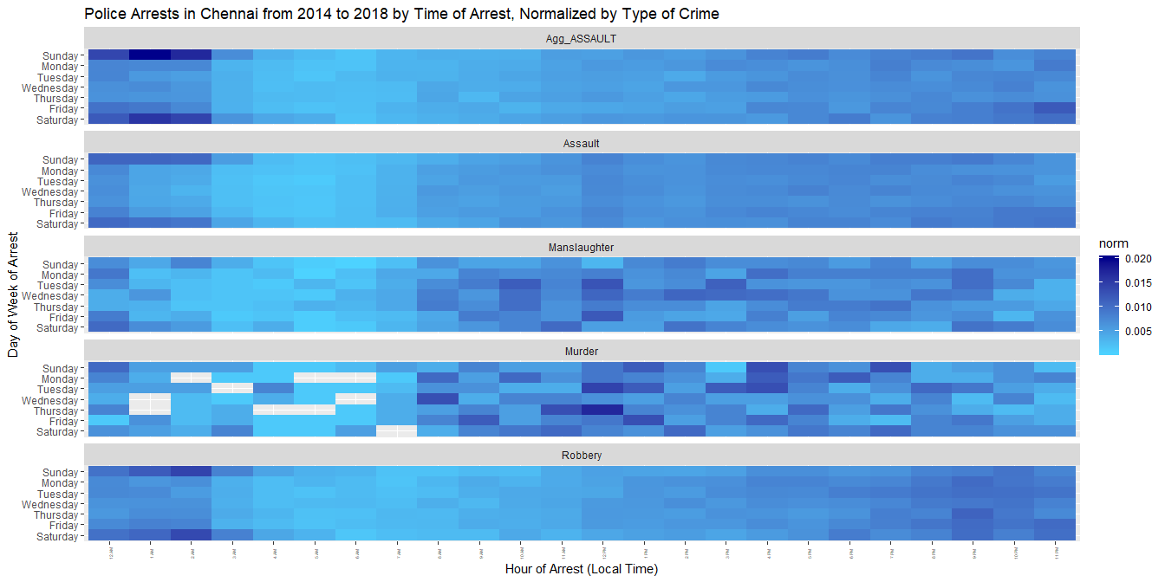

Slide 54
Arrest by Time, Normalized by Police District
df_arrest_time_district <- df_arrest %>% mutate(Hour = sapply(Time, get_hour)) %>% group_by(PdDistrict, DayOfWeek, Hour) %>% summarize(count = n()) %>% group_by(PdDistrict) %>% mutate(norm = count/sum(count)) df_arrest_time_district$DayOfWeek <- factor(df_arrest_time_district$DayOfWeek, level = rev(dow_format)) df_arrest_time_district$Hour <- factor(df_arrest_time_district$Hour, level = 0:23, label = hour_format) datatable(df_arrest_time_district, options = list(pageLength = 10,scrollX='400px'))

Slide 55
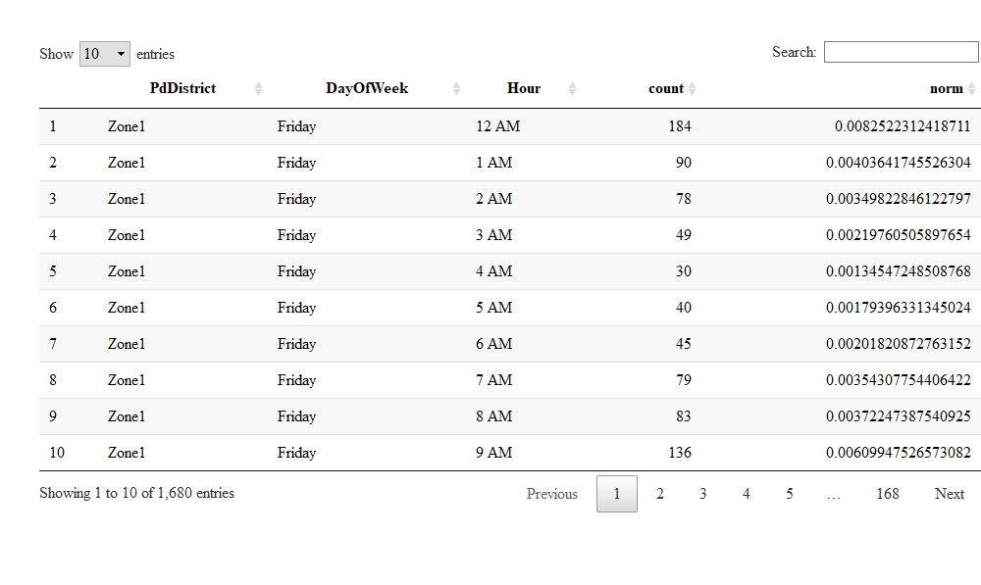

Slide 56
Plot of Arrest by Time, normalized by Police District
plot <- ggplot(df_arrest_time_district, aes(x = Hour, y = DayOfWeek, fill = norm)) + geom_tile() + theme(axis.text.x = element_text(angle = 90, vjust = 0.6, size = 4)) + labs(x = "Hour of Arrest (Local Time)", y = "Day of Week of Arrest", title = "Police Arrests in Chennai from 2014 to 2018 by Time of Arrest, Normalized by Station") + scale_fill_gradient(low = "white", high = "#ff4500") + facet_wrap(~ PdDistrict, nrow = 4) plot

Slide 57
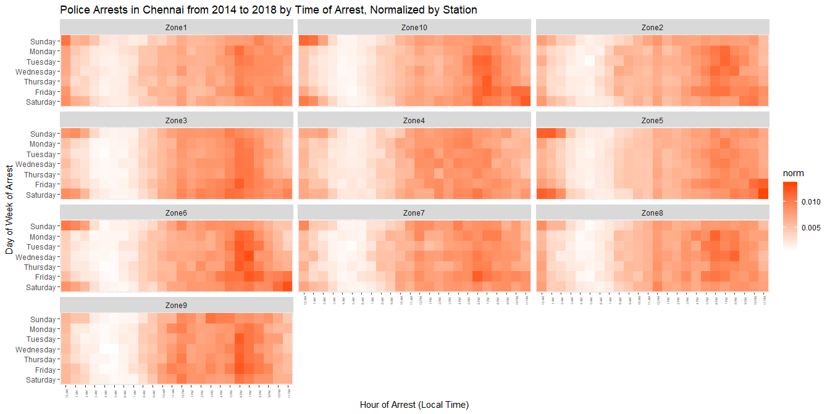

Slide 58
Arrests Time of Arrest, Normalized by Month
df_arrest_time_month <- df_arrest %>% mutate(Month = format(as.Date(Date, "%m/%d/%Y"), "%B"), Hour = sapply(Time, get_hour)) %>% group_by(Month, DayOfWeek, Hour) %>% summarize(count = n()) %>% group_by(Month) %>% mutate(norm = count/sum(count))

Slide 59
Resetting the Facets
Here, we set order of month facets by chronological order instead of alphabetical.
df_arrest_time_month$DayOfWeek <- factor(df_arrest_time_month$DayOfWeek, level = rev(dow_format)) df_arrest_time_month$Hour <- factor(df_arrest_time_month$Hour, level = 0:23, label = hour_format) df_arrest_time_month$Month <- factor(df_arrest_time_month$Month, level = c("January","February","March","April","May","June","July","August","September","October","November","December"))

Slide 60
Plot of Arrests by Time, Normalized by Month
plot <- ggplot(df_arrest_time_month, aes(x = Hour, y = DayOfWeek, fill = norm)) + geom_tile() + theme(axis.text.x = element_text(angle = 90, vjust = 0.6, size = 4)) + labs(x = "Hour of Arrest (Local Time)", y = "Day of Week of Arrest", title = "Police Arrests in Chennai from 2009 to 2018 by Time of Arrest, Normalized by Month") + scale_fill_gradient(low = "#9bfdff", high = "#4401ff") + facet_wrap(~ Month, nrow = 4) plot

Slide 61
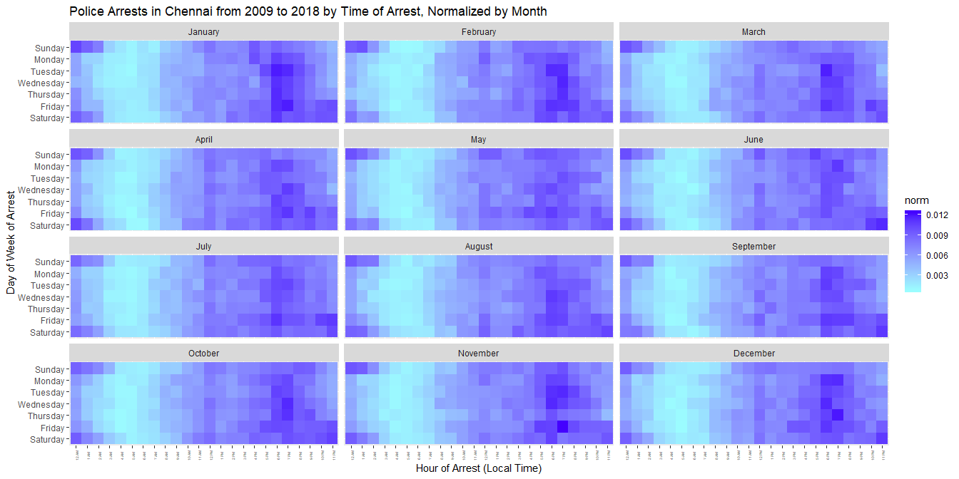

Slide 62
Arrests by Time, Normalized by Year
what if things changed overtime?
df_arrest_time_year <- df_arrest %>% mutate(Year = format(as.Date(Date, "%m/%d/%Y"), "%Y"), Hour = sapply(Time, get_hour)) %>% group_by(Year, DayOfWeek, Hour) %>% summarize(count = n()) %>% group_by(Year) %>% mutate(norm = count/sum(count)) df_arrest_time_year$DayOfWeek <- factor(df_arrest_time_year$DayOfWeek, level = rev(dow_format)) df_arrest_time_year$Hour <- factor(df_arrest_time_year$Hour, level = 0:23, label = hour_format)

Slide 63
Plot of Arrest by Time Normalized by Year
plot <- ggplot(df_arrest_time_year, aes(x = Hour, y = DayOfWeek, fill = norm)) + geom_tile() + # fte_theme() + theme(axis.text.x = element_text(angle = 90, vjust = 0.6, size = 4)) + labs(x = "Hour of Arrest (Local Time)", y = "Day of Week of Arrest", title = "Police Arrests in Chennai from 2014 to 2018 by Time of Arrest, Normalized by Year") + scale_fill_gradient(low = "#01ff44", high = "#00340e") + facet_wrap(~ Year, nrow = 6) plot

Slide 64
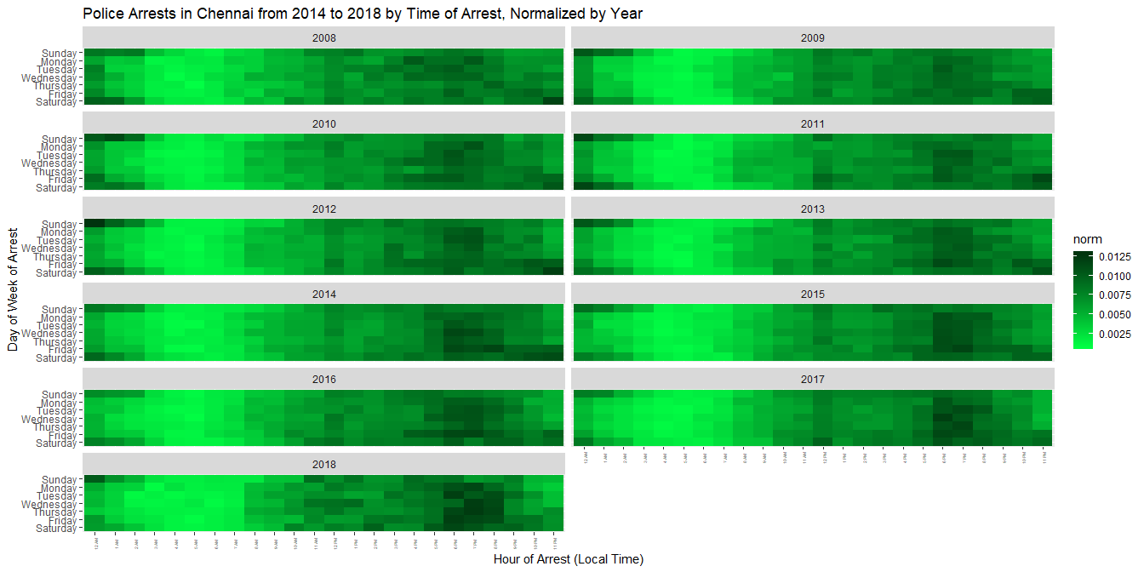

Slide 65
Works CIted

